Slide 1
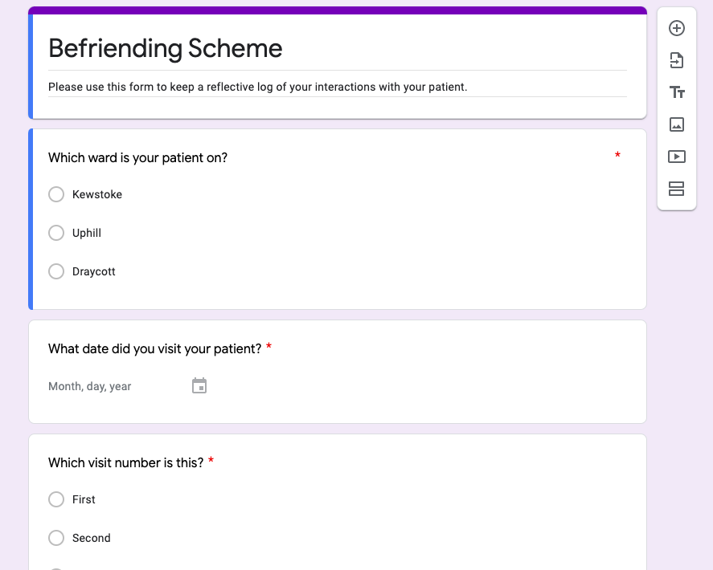
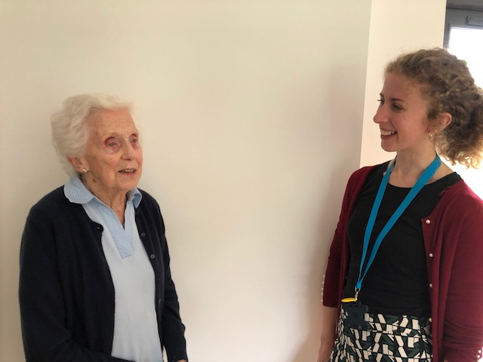
Developing Medical Professionalism Through a Befriending Scheme
Dr Rebecca Jordan
Background
The Visits
Pilot Scheme
Our pilot scheme involved third year medical students only. Results from the reflective logs indicate that students enjoyed getting to know their patients on a personal level. They also reported that the patients’ mood appeared to improve after talking to them.
Secondary learning outcomes were also reported, such as learning how to communicate with confused patients. We believe these learning events will help our students to develop into perceptive and experienced professionals.
The scheme was then expanded to include fifth year medical students.
The Befriending Scheme at Weston General Hospital aims to develop professionalism in medical students by forming a partnership with elderly patients.
The Royal College of Physicians describes medical professionalism as a partnership between patient and doctor, one based on mutual respect, individual responsibility, and appropriate accountability.(1) The scheme nourishes such attitudes through students spending time understanding an elderly patient’s perspective, whilst loneliness in hospital is also combated.
What did you discuss?
Talked about her life. She told me how to cook a chicken and that I’ve been doing it wrong my whole life!
Discussed her health conditions, her family and plans for Christmas.
Visits lasted between 15 minutes – 1 hour.
We spoke about how she was feeling after her stroke
Did the patient express any feelings of loneliness?
Befriending Scheme
How did you feel at the end of the visit?
Patients who were deemed to be at risk of loneliness by staff on long-stay wards were identified by junior doctors and paired with a volunteer medical student.
Students were encouraged to visit twice a week and keep a log of what they discussed, as well as their reflections upon the interaction in a standardised form.
Nice to have a chat with a patient in a non-medical scenario and for a longer period of time
Positive experience – I felt more happy and cheerful afterwards
So happy. One of the best things I’ve done here.
Good – it was lovely to meet her and chat for a while
Nice to keep someone company.
Reflective Log
Very isolating for patients being in hospital alone, apart from loved ones
Befriending Schemes help to:
Nurture a partnership between patients and future clinicians
Encourage reflective practice
Tackle loneliness in hospitals
How do you think the patient felt at the end of the visit?
Students used the form at the end of each visit to reflect upon what they had learnt from the interaction. Encouraging reflective practice early in medical school helps to develop the student’s professional practice.
Happy I think – much more cheerful by the end of the visit and I have planned to see her tomorrow as well
Hopefully happy to have someone to talk to/express her issues
Valuable to follow-up with someone
Nice to converse with a patient as a person
Nice to see a friendly, familiar face
Happy to have met someone new
There are no conflicts of interest.
References: (1) ASSESSMENT DEPARTMENT DEFINITION OF MEDICAL PROFESSIONALISM. (2018). [online] . Available at: https://www.rcpath.org/uploads/assets/4738fece-a557-4d78-9bb6b58cd33ddbc5/Definition-of-medical-professionalism.pdf [Accessed 28 Aug. 2021].
‌
I hope she felt better
Notes:
Hello, my name is Rebecca Jordan and I am a current FY3 doctor, I have just completed my foundation training in Severn Deanery. I am delighted to be presenting my project entitled ‘Developing Medical Professionalism Through a Befriending Scheme’ at this year’s Professionalism in Healthcare Conference.
The Royal College of Physicians definition of medical professionalism emphasises the importance of developing a partnership between patient and physician. I set up the Befriending Scheme at Weston General Hopsital in my F1 year to help develop a partnership between medical students and elderly patients. Secondary aims included developing reflective practice in medical students, which is a key part of professional practice, as well as tackling loneliness in hospitals. The pilot scheme involved identifying elderly patients on long-stay medical wards and pairing them with a 3rd year medical student. Students were encouraged to keep a reflective log after their visits using a standardised form (example form on right side of poster).
The middle of the poster displays examples of students records in their reflective log. Visits lasted between 15 minutes and 1 hour. Students reported discussing each-other’s life stories and experiences as well as the patient’s health problems. Students reported feeling happier after the visits and enjoyed conversing with and getting to know the patient as a person rather than only focusing on their medical problems, facilitating a more holistic approach. They also saw the value in following up with patients over a period of time. When asked how they thought the patient felt at the end of the visit they reported that the patients seemed more cheerful and happier, 43% of patients had expressed feelings of loneliness and students felt the visits helped to reduce this feeling of isolation.
After the successful pilot, the Befriending Scheme was expanded to include 5th year medical students. Unfortunately, due to the Covid-19 pandemic the scheme was put on hold. However, we hope that visits can soon resume, particularly as patients are likely to be feeling even more isolated during the pandemic due to visiting restrictions.
In summary, we found that befriending schemes help to nurture a partnership between patients and medical students, as well as encouraging reflective practice, both of which help to develop professionalism in future clinicians. We hope that our positive experience will encourage others to adopt a Befriending Scheme into their hospitals.
Thank-you.

