Slide 1
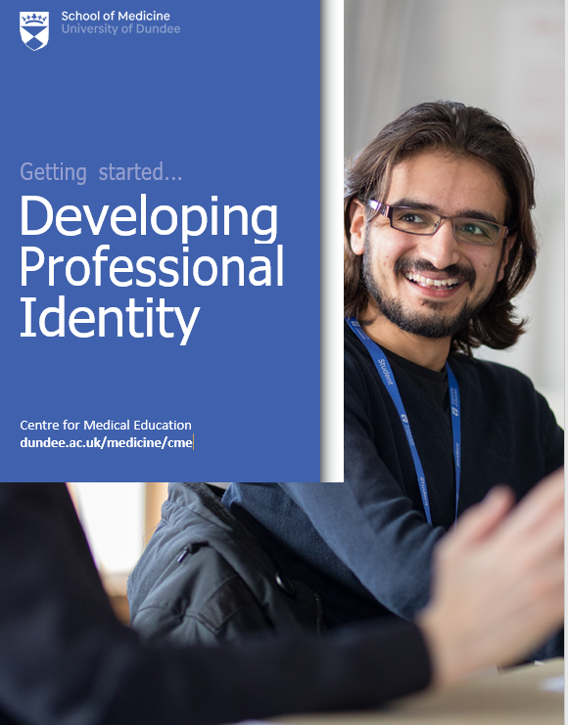
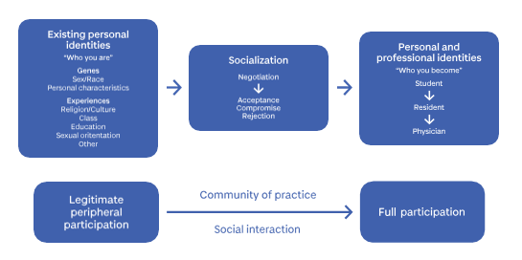
Reframing ‘Teaching Professionalism’ into ‘Developing Professional Identity’:
The challenge for medical educators. Professor Mairi Scott, Centre for Medical Education, School of Medicine, University of Dundee. UK. ( M.Z.Scott@dundee.ac.uk)
Why Professional Identity matters?
What is Professional Identity?
8 Top Tips to Professional Identity development
Section 3
Strong professional identity can be beneficial to healthcare practice; good for patient safety; result in better practice and patient outcomes; increase satisfaction with practice; decrease stress; improve retention and recruitment of practitioners and enhance career choice, well- being and life satisfaction (Monrouxe, 2016).
Furthermore, having a strong shared identity (e.g., interprofessional identity) with an understanding of the different roles and responsibilities of others can foster trust and facilitate teamwork performance in high intensity situations. ‘Interprofessional identity’ offers as a “...sense of belonging to own profession and interprofessional community...” (Khalili et al., 2013, p. 451)
“A representation of self, achieved in stages over time during which the characteristics, values, and norms of the medical profession are internalized, resulting in an individual thinking, acting, and feeling like a physician…”
(Cruess et al., 2019, p. 648).
“Professional identity is both a moral and formal obligation. These same behaviours, skills and attitudes are also expected regarding interprofessional collaborations and activities” (Khalili et al., 2013).
1.Establish professional identity formation as an educational objective (Cruess et al., 2016a)
2.Encourage communities of practice to share the values and norms of the community (Woods et al., 2016)
3.Develop a nurturing environment to ensure “professionalism is grown, not made” (Burford et al., 2014, p. 361)
4.Encourage early training in professional identity in medical schools (Goldie, 2012)
5.Develop a philosophy that professional identity must be intentionally taught, not left to chance (Cruess et al., 2014)
6.Establish an assessment programme (Cruess et al., 2016a)
7.Encourage institutional support and provide faculty development (Cruess et al., 2016a)
8.Allocate responsibility (Cruess et al., 2016a)
Getting Started Booklet Series
CME
Professional Identity Formation through Socialisation in Medical Education
Getting Started Acknowledgements
References;
Cruess, R. L., Cruess, S. R., & Steinert, Y. (2016a). Teaching medical professionalism : supporting the development of a professional identity. Cambridge University Press
Goldie, J. (2012). The formation of professional identity in medical students: considerations for educators. Med Teach, 34(9), e641-648.
Khalili, H., Orchard, C., Laschinger, H. K., & Farah, R. (2013). An interprofessional socialization framework for developing an interprofessional identity among health professions students. J Interprof Care, 27(6), 448-453.
Monrouxe, L. V., Rees, C. E., & Hu, W. (2011). Differences in medical students’ explicit discourses of professionalism: acting, representing, becoming [Research Support, Non- U.S. Gov’t]. Med Educ, 45(6), 585-602
Booklet written by Dr Kevin McConville & Dr Fiona Muir & edited by Professor Mairi Scott .
Getting Started Series free download at; https://apply.dundee.ac.uk/CME-Getting-started-2020-21-lp.html?utm_content=bufferae745&utm_medium=social&utm_source=twitter.com&utm_campaign=buffer
Video Series at; https://www.youtube.com/playlist?list=PLgPdWYi79WUT4anGvsr82-nqPm_ItCMPK
A schematic representation of professional identity formation, indicating that individuals enter the process of socialization with partially developed identities and emerge with both personal and professional identities (upper portion). The process of socialization in medicine results in an individual moving from legitimate peripheral participation in a community of practice to full participation, primarily through social interaction.
(lower portion)(Cruess et al., 2015).

